Slide 1
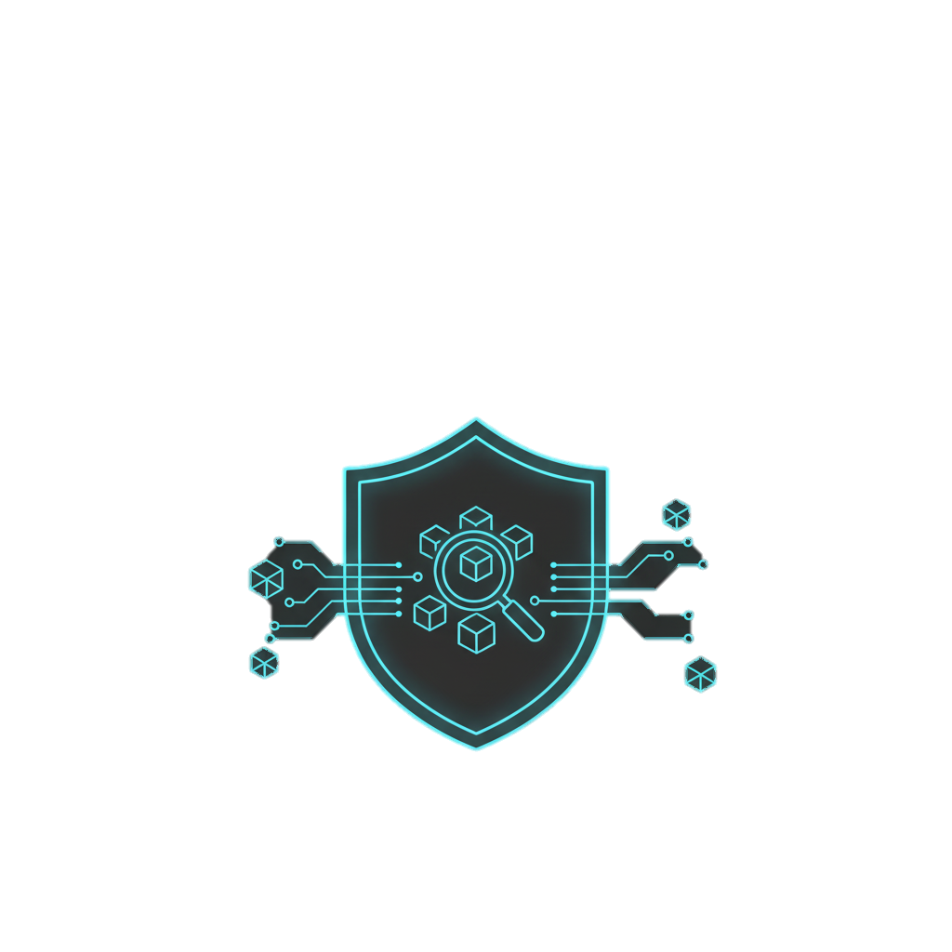
Veri-Chain Forensics: Decentralizing Trust in Cybersecurity
Team: Binary Brawlers Jainit Jain (24BCE11488) Harshil Srivastava (24BCY10399)
Date: September 15, 2025
CYBERSHIELD HACKATHON 2025

Slide 2
The Centralized Bottleneck in Incident Response
Traditional cybersecurity is broken. When a breach happens, the process is:
- Slow Siloed: Sharing critical threat intelligence between organizations is a manual, trust-dependent process that takes days or weeks.
- Lacks a Verifiable Audit Trail: It’s difficult to prove when evidence was collected and if it has been tampered with, creating legal and operational risks.
- Single Point of Failure: Central authorities that manage evidence can be compromised, destroying the integrity of an entire investigation.
- Opaque: There is no transparency for stakeholders to trust the forensic data they receive.

Slide 3

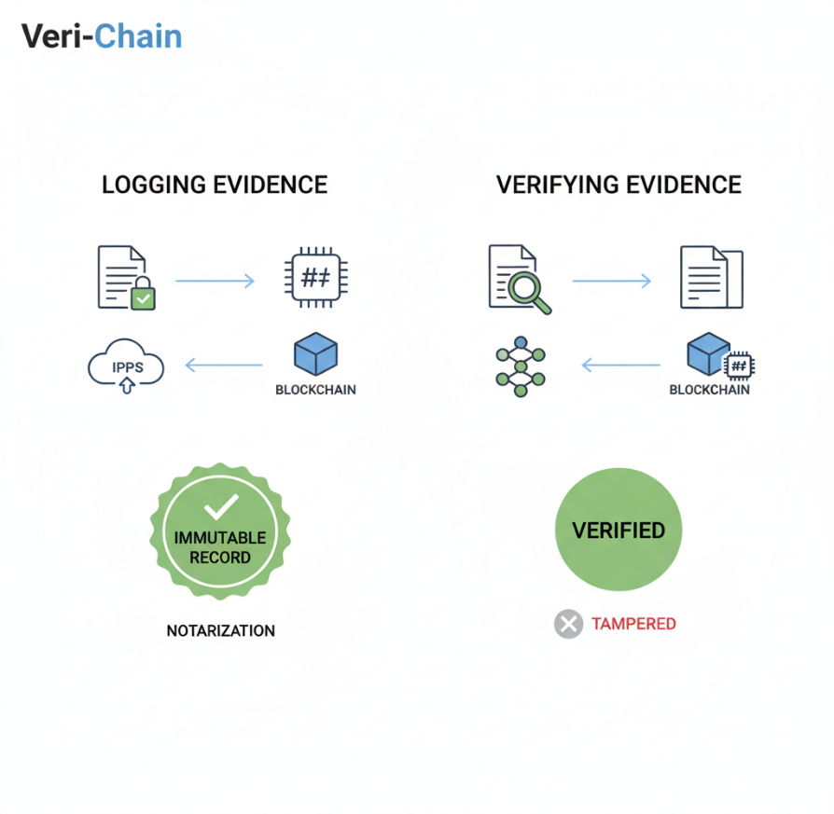
Introducing Veri-Chain: Trust as a Protocol
We've built a decentralized platform that provides an immutable, transparent, and auditable trail for digital evidence using blockchain and IPFS.
Our Core Mission: To replace the slow, centralized trust model with a fast, cryptographically-secure protocol
With Veri-Chain, any organization can:
Log evidence immutably on a shared ledger.
Store the raw evidence in a decentralized manner.
Verify the integrity and timestamp of any piece of evidence in seconds.

Slide 4
The Tech Behind the Trust
We use a combination of battle-tested, open-source technologies to build a robust and secure platform.
- Blockchain (Ethereum/Polygon): The Immutable Notary Our Solidity smart contract acts as a public notary. It doesn’t store the sensitive data itself, only the proof: the hash, the storage location (CID), the timestamp, and the submitting organization. Its our source of truth.
- IPFS (InterPlanetary File System): The Decentralized File Cabinet The actual evidence files (logs, pcap files) are stored on IPFS. This makes storage resilient, decentralized, and content-addressable, meaning the files address is its hash.
- Cryptography: The Digital Fingerprint We use hashing (SHA−256) to ensure data integrity and digital signatures to verify the authenticity of the submitting organization.

Slide 5

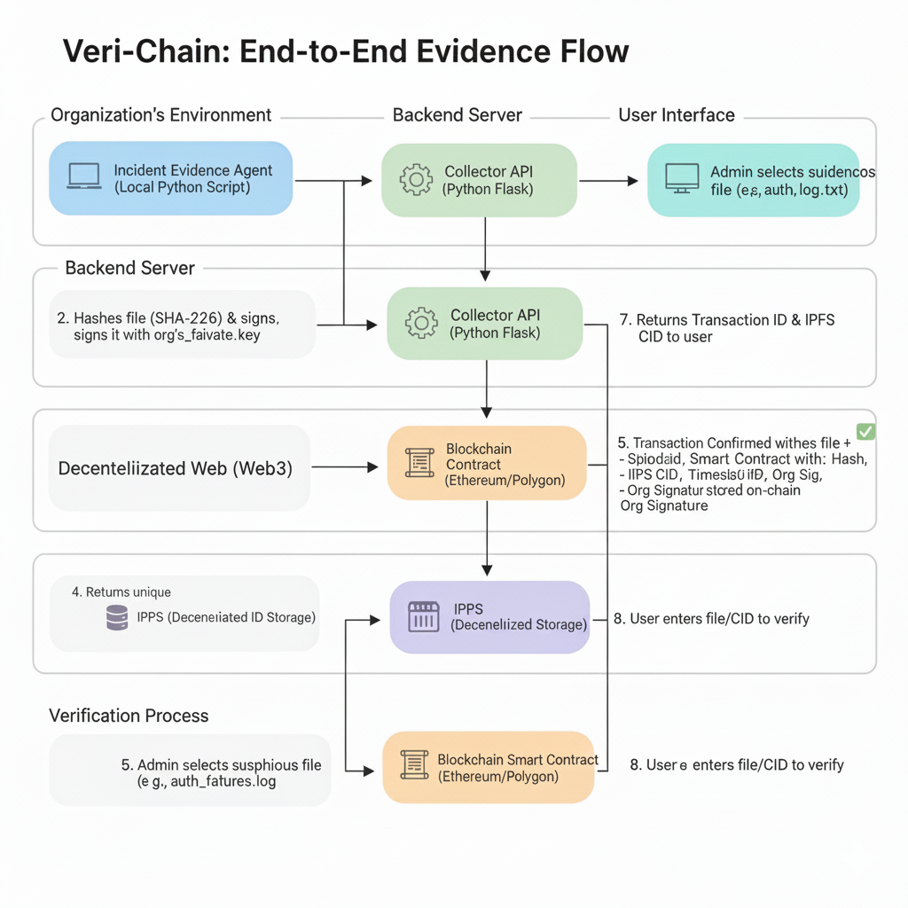
End-to-End Evidence Flow
Our architecture is simple, scalable, and secure, connecting the local environment to the decentralized web.
1. Incident Evidence Agent (Python) Runs at the organization It’s site. It selects an evidence file, then hashes and signs it.
1. Collector API (Python Flask) A lightweight backend that receives the signed proof and uploads the raw evidence file to IPFS.
1. Blockchain IPFS (Decentralized Layer) The API calls our Notary Smart Contract, which stores the file hash, IPFS CID, and timestamp on the blockchain forever.
1. Frontend Dashboard (React) A simple UI to upload and, more importantly, verify the integrity of any piece of evidence

Slide 6
On-Chaining Evidence in Seconds
Lets walk through how an organization logs a critical log file.
1. Select Evidence: An admin chooses a suspicious log file (auth_failures.log) via our dashboard or local agent.
2. Create Proof: The agent automatically calculates the file it’s hash (its unique fingerprint) and signs it with the organization private key.
3. Send to Chain: The agent sends the file and its signature to our Collector API. The API uploads the file to IPFS and calls our smart contract.
4. Confirmation: The blockchain confirms the transaction. A permanent, tamper-proof record is created, linking the files hash to a specific time. The user receives a transaction ID and an IPFS CID.

Slide 7
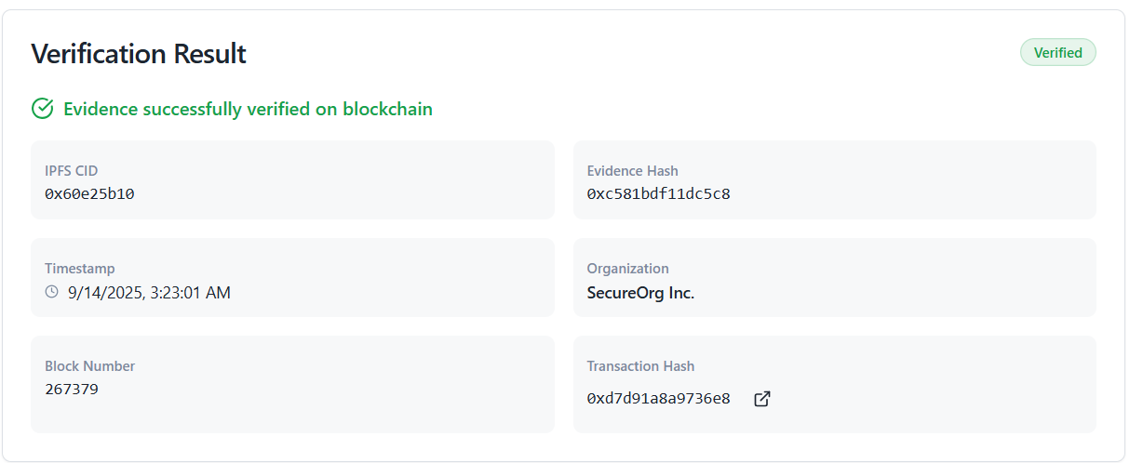
The Proof is on the Chain
Now, how can another organization (or an auditor) trust this evidence?
Input the CID: The user enters the IPFS Content ID (CID) of the evidence file into our "Verify" tab.
Fetch from IPFS: Our system retrieves the original file from the decentralized storage network.
Query the Blockchain: It then asks our smart contract: "What information do you have for this file's hash?"
Show the Proof: The dashboard displays the result directly from the blockchain:
Integrity Verified: The file's current hash matches the one stored on-chain.
Original Submitter: Organization_A_Address
Original Timestamp: Sep-15-2025 10:30:00 UTC

Slide 8
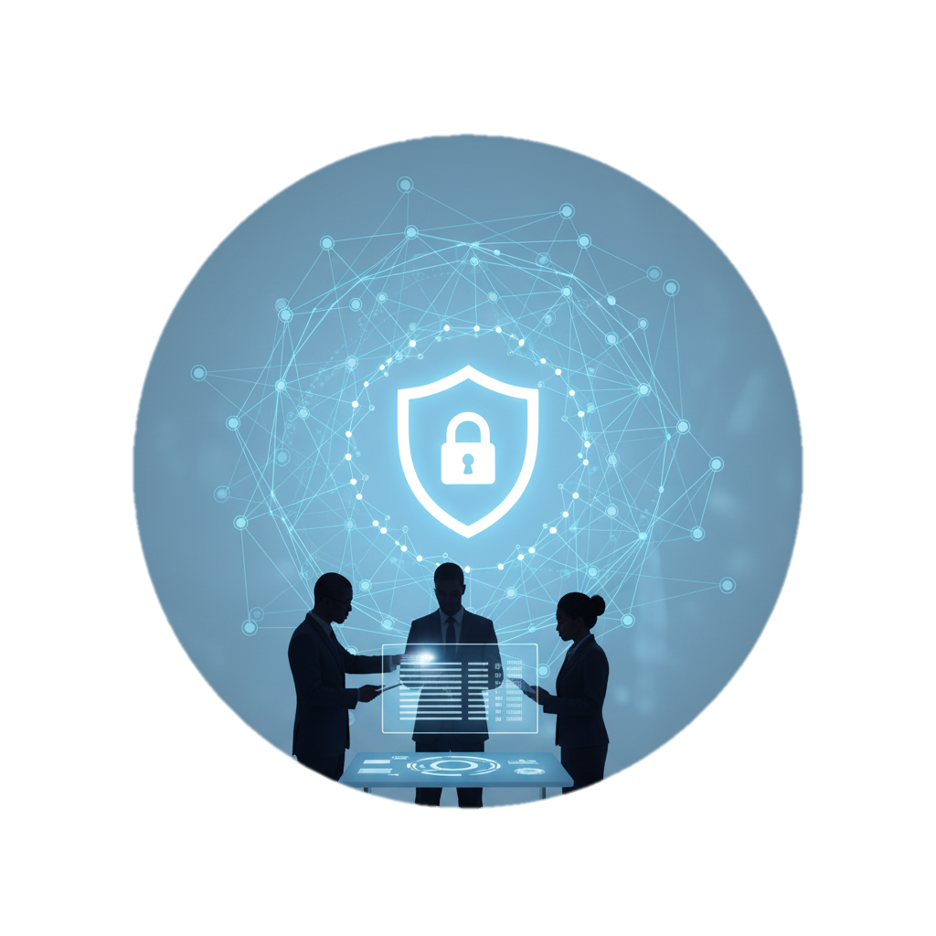
The Veri-Chain Advantage
Our decentralized approach directly solves the core problems of traditional incident response.
- Absolute Immutability Once evidence metadata is on the blockchain, it cannot be altered or deleted by anyone.
- Radical Transparency Any participating party can independently verify the audit trail without needing to trust a central authority.
- Unprecedented Speed Reduces the time to establish trust and share verifiable intelligence from days to seconds.
- Enhanced Security Eliminates the single point of failure. The system remains operational even if some nodes go offline.

Slide 9
Who Needs This?
Our platform is designed for any scenario where data integrity and a verifiable timeline are critical.
- Managed Security Service Providers (MSSPs): Provide clients with a transparent, trustworthy log of all actions taken during an incident.
- Inter-Organizational Threat Sharing: A consortium of banks or government agencies can share threat intelligence with cryptographic proof of its origin and time.
- Digital Forensics Investigators: Establish an unbreakable chain of custody for digital evidence that will hold up in court.
- Compliance Auditing: Allow auditors to instantly verify logs and data for regulations like GDPR, SOX, and HIPAA

Slide 10
From Fragile Trust to Cryptographic Proof
Traditional incident response relies on trusting people and centralized systems. We replace that with verifiable proof.
Veri-Chain transforms digital forensics by providing:
- An Immutable Audit Trail: Creates a permanent, tamper-proof record of evidence.
- Instant Verification: Allows anyone to prove data integrity in seconds.
- Resilience by Design: Eliminates the single point of failure.
- Accelerated Collaboration: Enables rapid, trusted intelligence sharing.
We are not just improving the process; we are building the future of trust in cybersecurity.

